Slide 1
t-Distributed Stochastic Neighbor Embedding (t-SNE)

Slide 2
PCA
PCA is mainly concerned with preserving large pairwise distances in the map.

Slide 3
Overview
t-SNE is a dimension reduction/data visualization method.
t-SNE tends to preserve local structure at the same time preserving the global structure as much as possible.
Proposed by Laurens van der Maaten & Geoffrey Hinton in 2008.

Slide 4
Objective
The objective is to match distributions of distances between point in high and low dimensional space via conditional probabilities.
Assume distances in both high and low dimensional space are Gaussian-distributed.

Slide 5
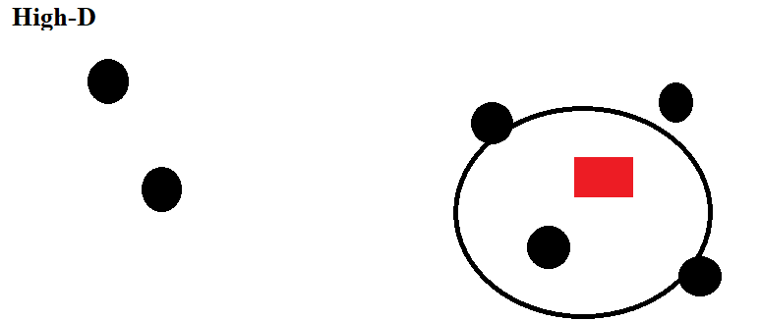

High Dimension
$$P_{ij}=\frac{\exp\left(−\frac{{\left|\left|X_{i} −X_{j}\right|\right|}^{2}}{2σ^{2}}\right)}{\sum_{k}^{ }{\sum_{i≠k}{\exp\left(−\frac{{\left|\left|X_{k}−X_{i}\right|\right|}^{2}}{2σ^{2}}\right)}}}$$

Slide 6
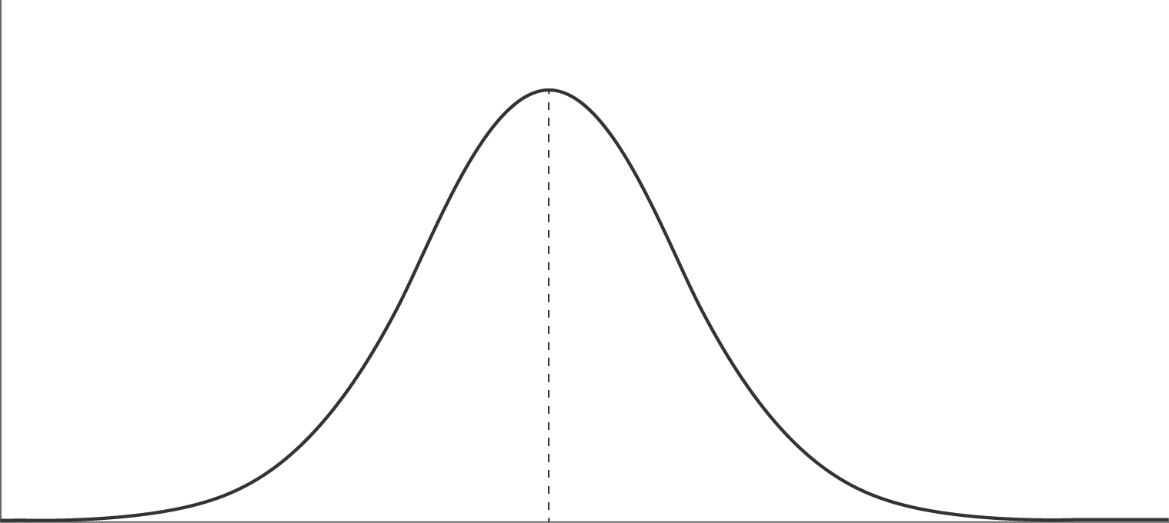
Gaussian distribution

Slide 7
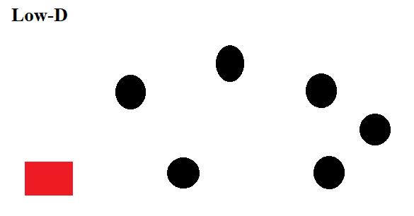

Low Dimension
$$q_{ij}=\frac{{\left(1+{\left|\left|y_{i} −y_{j}\right|\right|}^{2}\right)}^{−1}}{\sum_{k}{\sum_{l≠k}{{\left(1+{\left|\left|y_{k} −y_{l}\right|\right|}^{2}\right)}^{−1}}}}$$

Slide 8
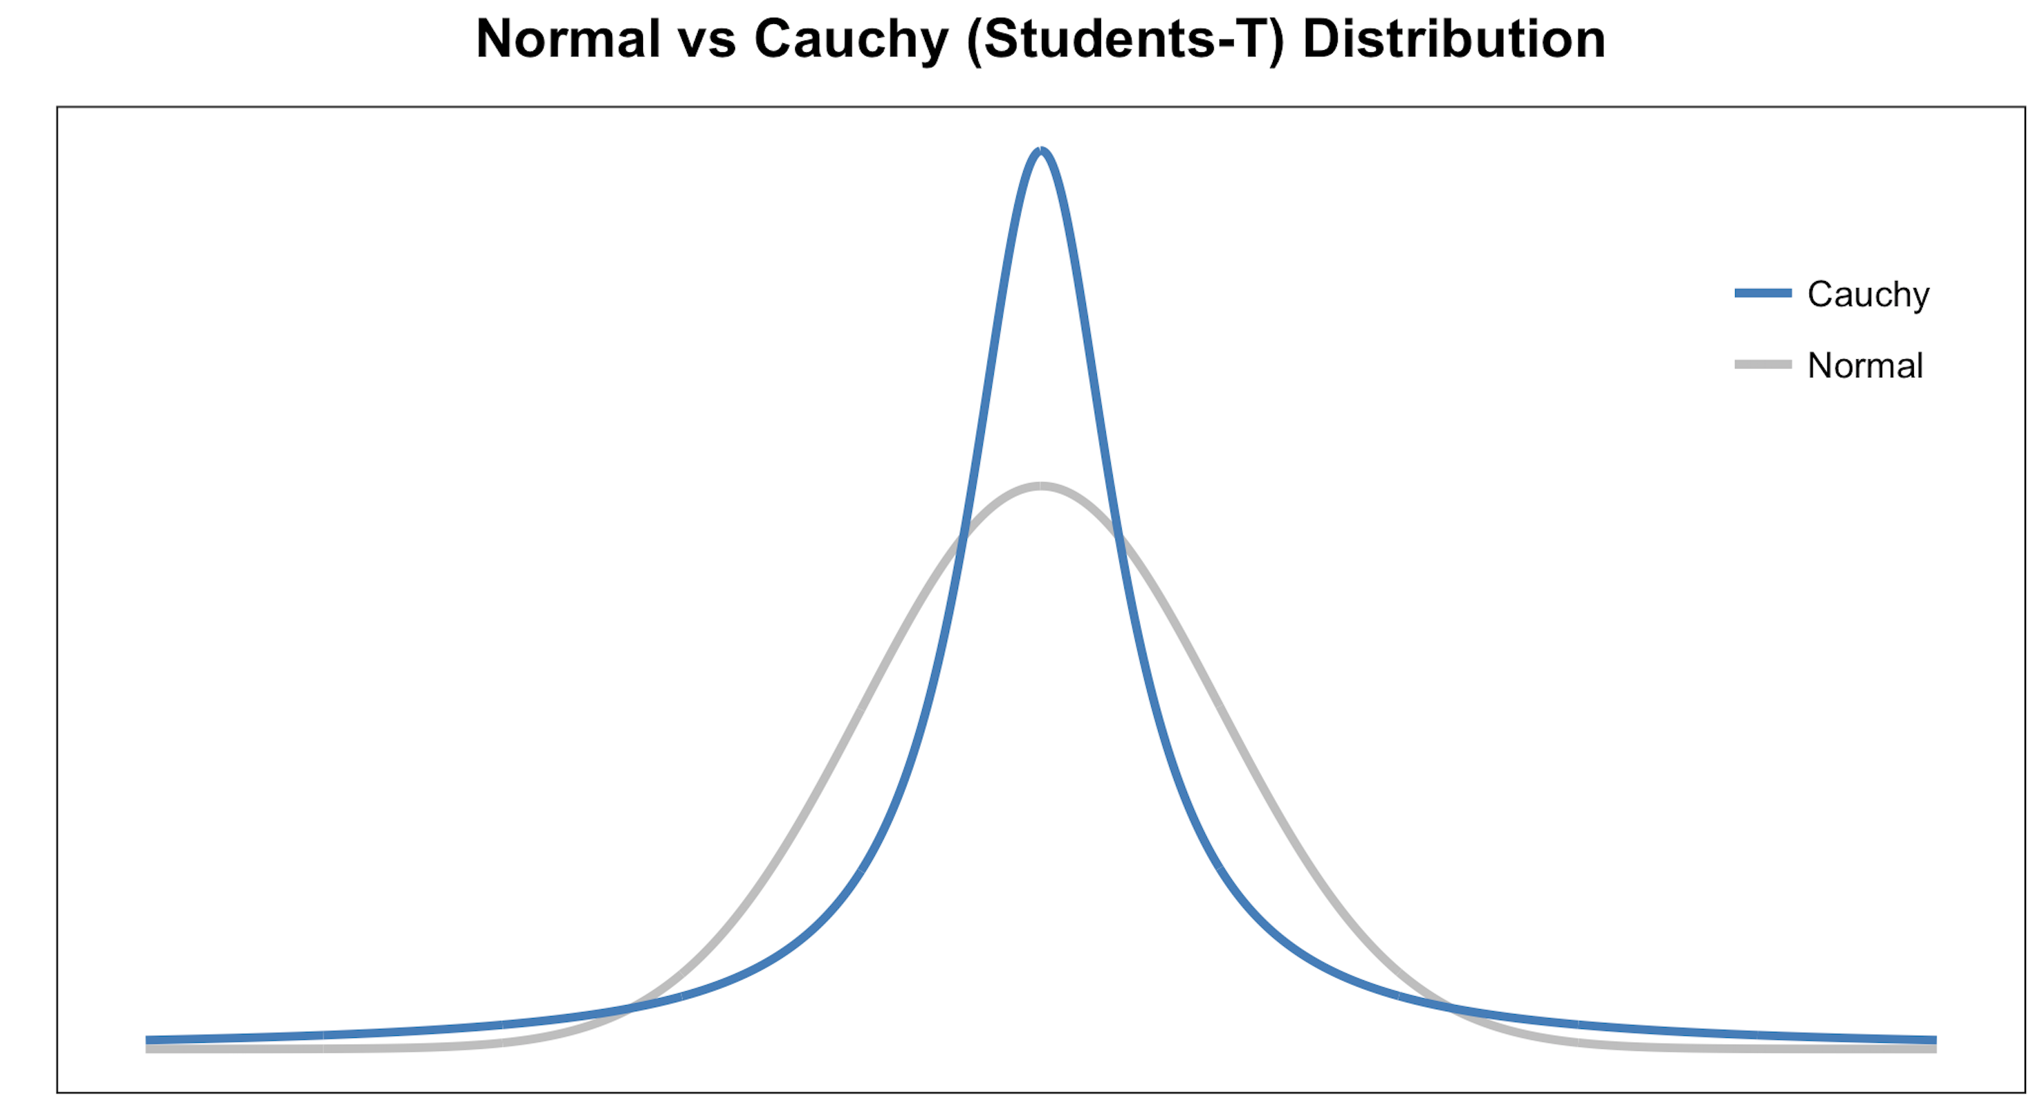
Student-t distribution
The student-t distribution with one degree of freedom is a distribution that has a heavier tilt than the Gaussian distribution.

Slide 9
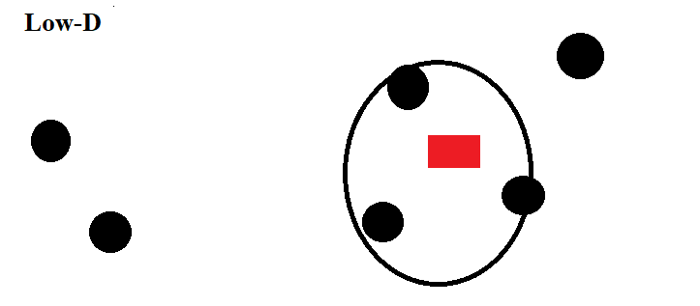
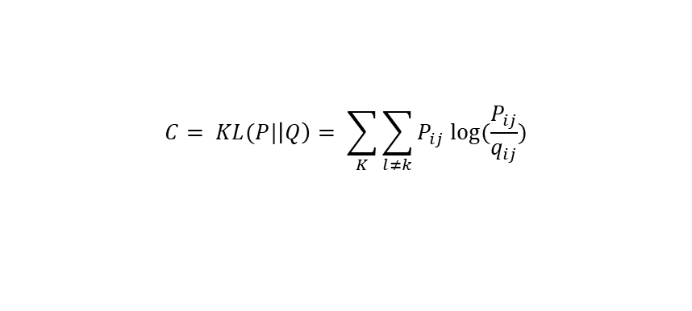
Low Dimension with Modification
$$C= KL(P|\left|Q\right)= \sum_{K}{\sum_{l≠k}{P_{ij} log⁡(\frac{P_{ij}}{q_{ij}})}}$$
Notes:
Large pij modeled by small qij : Large penalty
Small pij modeled by large qij : Small penalty
t-SNE mainly preserves local similarity structure of the data

Slide 10

Gradient interpretation
We can interpret the t-SNE gradient as a simulation of an N-body system.
$$\frac{∂C}{∂y_{i}}=4\sum_{j≠i}{\left(P_{ij} −q_{ij}\right){\left(1+{\left|\left|y_{i} −y_{j}\right|\right|}^{2}\right)}^{−1}(y_{i} −y_{j})}$$
Exertion / Compression
Displacement
(Spring)

Slide 11

Gradient interpretation
Displacement
$$\left(y_{i}−y_{j}\right)$$

Slide 12

Gradient interpretation
Exertion / Compression
$$\left(P_{ij} −q_{ij}\right){\left(1+{\left|\left|y_{i} −y_{j}\right|\right|}^{2}\right)}^{−1}$$

Slide 13

Gradient interpretation
Summation
$$\frac{∂C}{∂y_{i}}=4\sum_{j≠i}{\left(P_{ij} −q_{ij}\right){\left(1+{\left|\left|y_{i} −y_{j}\right|\right|}^{2}\right)}^{−1}(y_{i} −y_{j})}$$

Slide 14
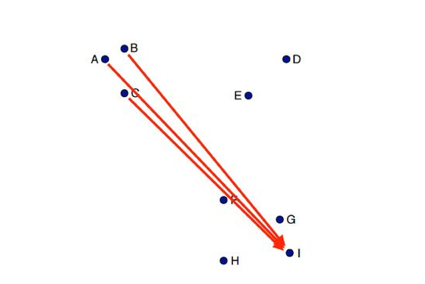
Barnes-Hut Approximation
Many of the pairwise interactions between points are very similar.

Slide 15
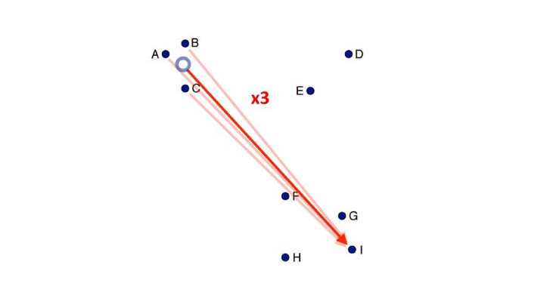
Barnes-Hut Approximation
Approximate similar interactions by a single interaction.

Slide 16
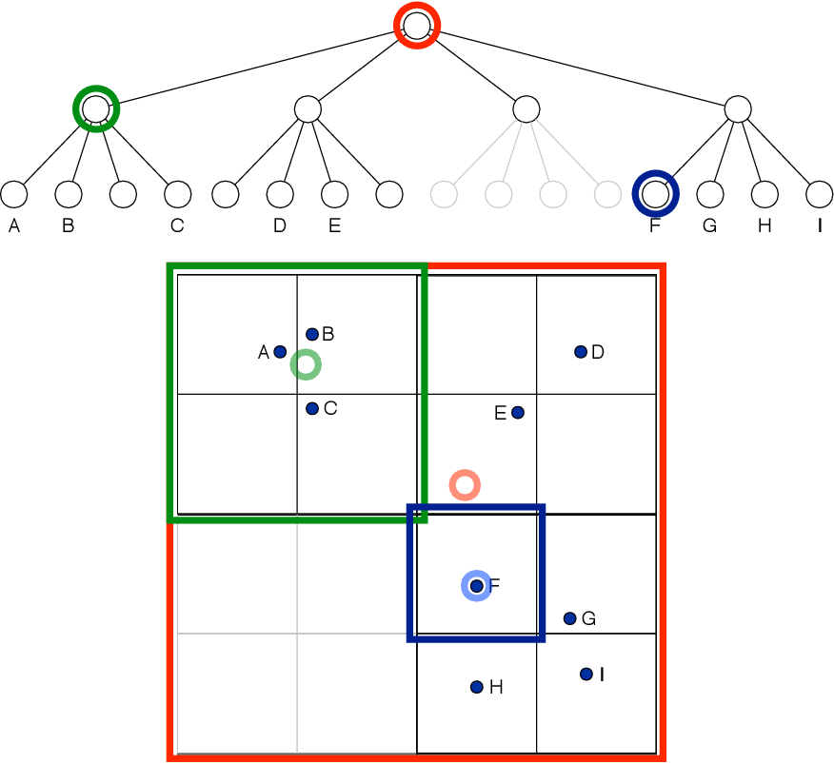
Quadtree
Quadtree is a space partitioning tree.

Slide 17
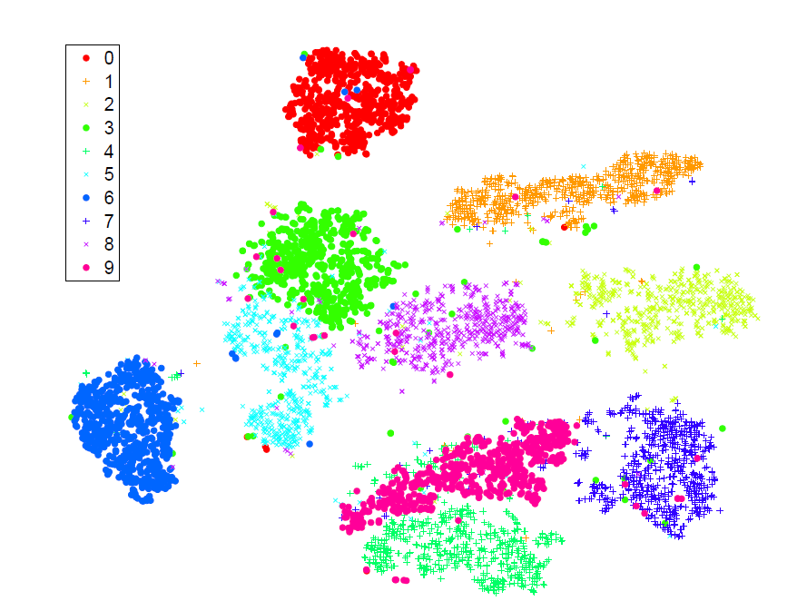
Visualization by t-SNE
MINST data

Slide 18


